Slide 1
Chester Upland School District
Office of Accountability
Fall Family Summit
Title I Parent Meeting
Parent, Family, and Community Engagement
November 2021

Slide 2
TITLE I
Agenda
* Title I Overview
* Annual Parent Meetings
* What is a Title I School?
* 1% Set-Aside
* Title II, III, and IV
* Title I Parent, Family, and Community Engagement
* ESSER
* Working Together
KEY TOPICS:
Title I, II, III, and IV Funding Sources
Parent and Family Engagement Policy
School-Parent Compact
Teacher Qualifications: Right-to-Know
Annual Evaluation
ESSER Funding
Federal Programs Monitoring
Complaints
Who to Contact?
This Photo by Unknown Author is licensed under CC BY-SA

Slide 3
Title I Overview Title I, Part A: Improving Basic Programs
Title I is a 100% Federally funded supplemental education program that provides financial assistance to local education agencies to improve educational opportunities for educationally deprived children.
Title I programs are designed to help children meet the state content and performance standards in reading, language arts, and mathematics.
Source: www.education.pa.gov

Slide 4
Annual Parent Meetings
Federal guidelines require Title I schools to hold an Annual Parent Meeting to explain and discuss Title I Schoolwide programs and requirements.

Slide 5
What is a Title I School?
Being a Title I, Part A school means receiving federal funding (Title I, Part A dollars) to supplement the school’s existing programs. These dollars can be used to support programs in the following ways:
Identifying students experiencing academic difficulties and providing timely assistance to help these students meet the State’s challenging content standards
Purchasing supplemental resources: staff salaries, programs, materials, and supplies
Conducting parent and family engagement meetings, trainings, and activities
Source: Pennsylvania Department of Education (PDE)

Slide 6
1% Set-Aside: PARENT & FAMILY ENGAGEMENT
If the LEA reserves $500,000 or more and is required to set aside 1%, funds shall be used to carry out activities and strategies consistent with the LEA’s parent and family engagement policy (education.pa.gov).
The district approved a revised LEA parent and family engagement policy June 2020.
The Chester Upland School District welcomes your help in planning programs and services for students.
Contact the Principal and/or Family Engagement Specialist (FES) at your school for more information.
Source: Pennsylvania Department of Education (PDE)

Slide 7
TITLE I PARENT AND FAMILY ENGAGEMENT
All Title I schools must allocate at least one percent of the Title I budget towards programs, activities, and procedures for parent and family engagement.
The Every Student Succeeds Act (ESSA) requires that all Title I schools and families work together.
Each school shall jointly develop with, and distribute to, parents and family members of participating children a Title I School/Parent Compact.
Source: Pennsylvania Department of Education (PDE)
This Photo by Unknown Author is licensed under CC BY-SA

Slide 8
Title II, Part A: Supporting Effective Instruction
Teacher and Principal Training & Recruitment
Provides financial assistance to improve teacher skills and quality of instruction in core academic areas
Key areas of professional development can include, but is not limited to the following:
Improving Student Teaching and Learning
Teacher and Principal Evaluation Systems
Recruitment and Retention
Technology Integration
English Learners
Safety and Chronic Absenteeism
Source: Pennsylvania Department of Education (PDE)

Slide 9
Title III: Language Instruction for English Learners
Title III provides financial assistance to support the English Language program.
Title III program support is designed to improve the education of Limited English Proficient (LEP) children and youth.
Title III also offers enhanced instructional opportunities for immigrant children and youth.
Key areas of support can include, but is not limited to the following:
Co-teaching classes with English only support
Sheltered English content classes
Intervention for literacy instruction
Professional development for teachers, staff, and administrators
Family engagement resources
Source: Pennsylvania Department of Education (PDE)

Slide 10
Title IV, Part A: Student Support and Academic Enrichment
Title IV provides financial assistance to support:
Well-rounded educational opportunities
Student health and safety
Effective technology use
Stakeholder engagement
Comprehensive needs assessment
Professional Development
Source: Pennsylvania Department of Education (PDE)

Slide 11
The Elementary and Secondary School Emergency Relief (ESSER) Funds
ESSER funds are distributed to states based on each state's proportionate share of Title I, Part A (Title I-A) funding from 2019.
ESSER funds are intended to support COVID-19 response efforts and may be spent on a wide range of allowable activities. This includes the following:
Coordinate preparedness and response efforts to COVID-19;
Provide principals and other school leaders with resources to address individual school needs;
Address the unique needs of low-income children, children with disabilities, English learners, racial and ethnic minorities, students experiencing homelessness, and foster care youth, including outreach and service delivery;
Implement systems to improve LEA preparedness and response efforts;
Deliver professional development for LEA staff on sanitation and minimizing the spread of infectious disease and purchasing supplies to sanitize and clean LEA facilities;
Plan for and coordinate operations during long-term closures, including how to provide meals, technology for online learning, guidance for carrying out IDEA requirements, and providing educational services consistent with applicable requirements;
Purchase educational technology (including hardware, software and connectivity) for students;
Provide staff and student mental health services and supports;
Plan and implement summer learning and supplemental afterschool programs; and
Initiate other activities necessary to maintain LEA operations and services and employ existing LEA staff, including any activity authorized by ESEA which include the Title programs, IDEA, Adult Education and Family Literacy Act, Perkins, and McKinney-Vento.
Source: https://www.education.pa.gov/Schools/safeschools/emergencyplanning/COVID-19/CARESAct/May2020/Pages/FAQs.aspx#:~:text=How%20much%20ESSER%20funding%20did,Title%20I%2DA%20allocations%20in%202019.

Slide 12
Working Together
The ESSA law requires that all Title I schools and families work together.
The following documents are a collaboration between school and family:
2021-2022 School Improvement Plan
2021-2022 Family Engagement Policy
2021-2022 School/Parent Compact

Slide 13
Parent and Family Engagement Policy
The policy addresses how the school will implement the parent and family engagement program. The policy includes the following:
Convene an annual meeting
Provide a flexible number of meetings
Engage parents in an organized, ongoing, and timely way, in the planning, review, and improvement of the parent and family engagement program
Source: Pennsylvania Department of Education (PDE)

Slide 14
Parent and Family Engagement Policy
Provide timely information about parent and family engagement activities
Provide information to parents about curriculum and assessment
If requested, provide additional meetings with parents to discuss decisions for the education of their child
Title I parents have the right to be involved in the development of the school policy
Source: Pennsylvania Department of Education (PDE)

Slide 15
District and School Title I Parent and Family Engagement Policy Revisions
District and school policies for parent and family engagement are reviewed annually
The process for updating these policies include providing parents an opportunity to review and give feedback on these policies.
Principals will share school level policies with their respective school communities for 2021-22 revisions.

Slide 16
School-Parent Compact
The school-parent compact is a written agreement that…
Addresses high-quality curriculum and instruction
Describes how parents and families, school staff, and students share the responsibility for improved student academic achievement
Source: Pennsylvania Department of Education (PDE)

Slide 17
School-Parent Compact
Stresses the importance of frequent communication between school and home, and the value of parent-teacher conferences (required in elementary schools)
Affirms the importance of parents and families in decisions relating to the education of their children
Title I parents have the right to be involved in the development of the school-parent compact
Source: Pennsylvania Department of Education (PDE)

Slide 18
TEACHER QUALIFICATIONS
Schools are required to notify parents that they have the right to request information regarding the qualifications of their child’s teacher.
Parents must follow the school procedure to request this information.
Check with your school office or district office to learn more about the requirements.
Source: Pennsylvania Department of Education (PDE)

Slide 19
ANNUAL EVALUATION
The content and effectiveness of the family and parent engagement policy as well as the program must be evaluated annually.
This includes identifying barriers to participate.
Data and input might include the following:
Parent questionnaires and surveys
Focus groups
Parent advisory committee input
Findings are reported to parents and families.
The data results are used to revise the parent and family engagement policy and school-parent compact.
Source: Pennsylvania Department of Education (PDE)
Family and Parent Engagement

Slide 20
FEDERAL PROGRAMS MONITORING
According to the PDE Federal Programs Monitoring Tool:
“The LEA may receive funds under this part only if such agency conducts outreach to all parents and family members and implements programs, activities, and procedures for the involvement of parents and family members in programs. Such programs, activities, and procedures shall be planned and implemented with meaningful consultation with parents of Title I students.”
Source: Pennsylvania Department of Education (PDE)

Slide 21
The Consolidated Application Title I, II, III, and IV
Assessing program needs
Program planning with stakeholder engagement
Setting performance goals
Program implementation
On-going progress monitoring

Slide 22
COMPLAINTS
Title I requires communication of the district complaint policy. It includes the following:
To make available to individuals and groups the opportunity of a fair, adequate and expeditious hearing on any problems or points of information they may have.
Any misunderstanding between the public and the school district shall be resolved by direct discussions of informal type among the interested parties.
Chester Upland School District, Board Policy 906

Slide 23
COMPLAINTS
When such informal meetings fail, the following formal procedures occur:
Investigate any alleged aggrieved act of parents, students, teachers, administrators or service personnel.
There shall be provided in the principal’s office, guidance office, other places in the schools, and Administration Building, complaint forms for use by any aggrieved party. The form shall be filled out and filed with the Superintendent for action.
The complaint form outlines the district procedures for submission.
Policies can be found on the district website at https://www.chesteruplandsd.org/domain/61.
Chester Upland School District, Board Policy 906

Slide 24
Who to Contact?
Contact the principal at your school for more information about programs and family engagement specialist (FES) support.

Slide 25
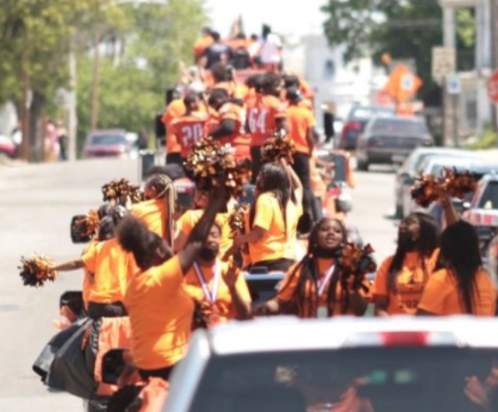
SCHOOLS
Chester High School
(9 – 12 Grade)
Principal: Pearl Cameron
200 West 9TH Street
Chester, PA 19013
Phone: (610) 447-3600
Stem Academy
(9-12 Grade)
Principal: Brendan Bell
1100 W 10TH Street
Chester, PA 19013
Phone: (610) 447-3650

Slide 26
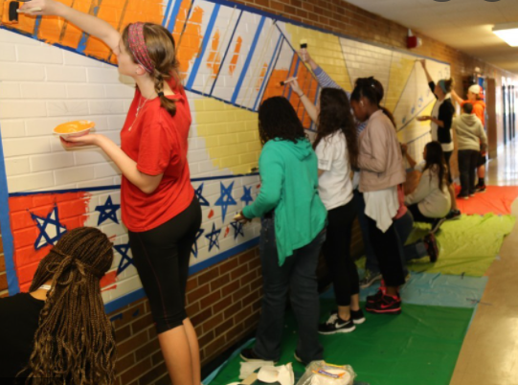
SCHOOLS
Toby Farms Intermediate School
(6-8 Grade)
Principal: LaMonte Popley
201 Bridgewater RD
Brookhaven, PA 19015
Phone: (610) 447-3815
Main Street Elementary
(Pre-K - 5 Grade)
Principal: Darenell Medley
704 Main Street
Upland, PA 19015
Phone: (610) 447-3685

Slide 27
SCHOOLS
Chester Upland School of the Arts
(Pre-K – 5 Grade)
Principal: Rene Garner
501 W. 9TH Street
Chester, PA 19013
Phone: (610) 447-7777
Stetser Elementary
(Pre-K - 6 Grade)
Principal: Dr. Lavada Green
808 E 17TH Street
Chester, PA 19013
Phone: (610) 447-3795

Slide 28
Administration Building
Monique Hales, Special Initiatives
Revenue Development ~ Federal Programs
Administration Building
232 West 9TH Street
Chester, PA 19013
E: mhales@chesteruplandsd.org
P: (610) 447-3618
Dejuana Mosley, Account Specialist
E: dmosley@chesteruplandsd.org
P: (610)447-3632

Slide 29
Please email questions about the Annual Title I Parent Meeting presentation to mhales@chesteruplandsd.org

Slide 30
THANK YOU!

